Slide 1
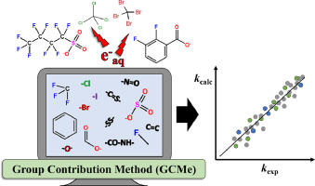
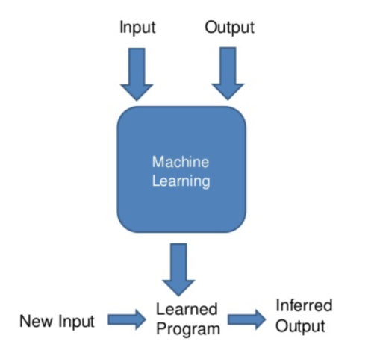
Introduction
QSPR & Machine Learning
QSPR (Quantitative structure−property relationship) establishes relations between a molecule's structure and its properties using mathematical or statistical methods. The QSPR model is used to predict the properties of molecules from molecular structures.
Traditional QSPR Model
Group Contribution
Modern QSPR Model
Machine Learning
Similar Group Structure
perform complicated calculations
Figure 2. Group Contribution
Figure 3. Machine Learning
Ref [3] : A review on machine learning algorithms for the ionic liquid chemical space, https://doi.org/10.1039/D1SC01000J
Ref [4] : New Group Contribution Method for Estimating Properties of Pure Compounds , https://doi.org/10.1002/aic.690401011
Notes:
https://pubs.acs.org/doi/epdf/10.1021/acs.jpcb.8b11108
https://www.sciencedirect.com/science/article/abs/pii/S0032591020304927 https://www.google.com/url?sa=i&url=https%3A%2F%2Fwww.sciencedirect.com%2Fscience%2Farticle%2Fpii%2FS2666821123000509&psig=AOvVaw3TjyM6Y_T_QNQ3Ydg-_5eB&ust=1699805605215000&source=images&cd=vfe&opi=89978449&ved=0CBIQjRxqFwoTCIDcwLqrvIIDFQAAAAAdAAAAABAE

Slide 2
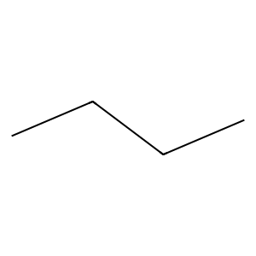
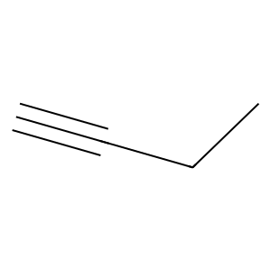
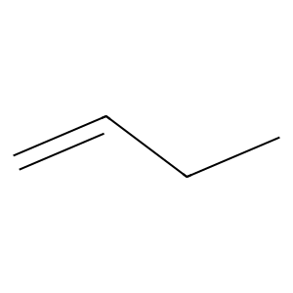
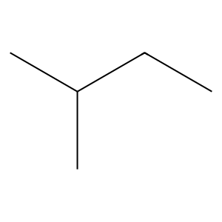
Introduction
Review SMILES
The simplified molecular-input line-entry system (SMILES) is a specification in the form of a line notation for describing the structure of chemical species using short ASCII strings.
SMILES | CCCC
SMILES | C#CCC
Figure 4. Butane
Figure 6. Butyne
SMILES | C=CCC
SMILES | C(C)CCC
Figure 5. Butene
Figure 7. Isopentane
Notes:
Represent in 1. Atom 2. Bond 3. Ring
4. Aromatic 5. Stereochemistry 6. Isotope

Slide 3
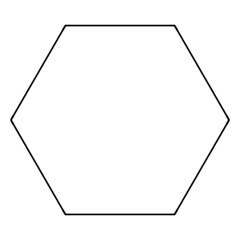
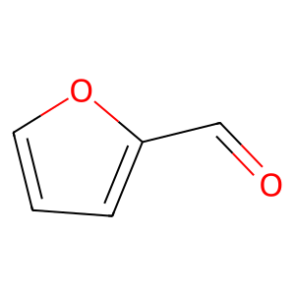
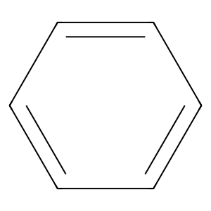
Introduction
Review SMILES
SMILES | C1CCCCC1
Figure 8. Cyclic
Figure 10. Furfural
SMILES | c1ccccc1
SMILES | c1cc(C=O)oc1
Figure 9. Aromatic
Notes:
Represent in 1. Atom 2. Bond 3. Ring
4. Aromatic 5. Stereochemistry 6. Isotope

Slide 4
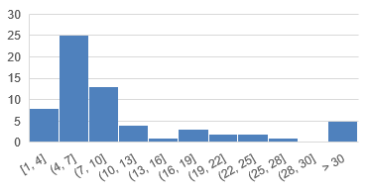
Bit Collision
Problem
Ideal Fingerprint
Bit 1 | C(O)C=C
1 Bit many substructure
1 same Bit, 1 same substructure for all molecule
Count-based Morgan Fingerprint
Bit 1 | C(O)C=C, C(N)C=C
Bit 2 | C(CO)CC#C
Bit 3 | C(CO)CC#C

Slide 5

Methodology
Machine Learning Flow
Data
Model Training
Training set
Ridge Regression
Data
Preparation
Random Forest
Training Set
Test set
Select machine learning algorithm
Extreme Gradient Boosting
Model
Training
K-Nearest Neighbors
Model training (Use K-Fold)
Evaluation
Prediction Model
Notes:
https://www.youtube.com/watch?app=desktop&v=Q81RR3yKn30
https://www.google.com/url?sa=i&url=https%3A%2F%2Fwww.mql5.com%2Fen%2Farticles%2F11735&psig=AOvVaw3gY1dKkTquxr1O7-X5ALwJ&ust=1698327817464000&source=images&cd=vfe&opi=89978449&ved=0CBMQjhxqFwoTCKjSo6SqkYIDFQAAAAAdAAAAABAy

Slide 6
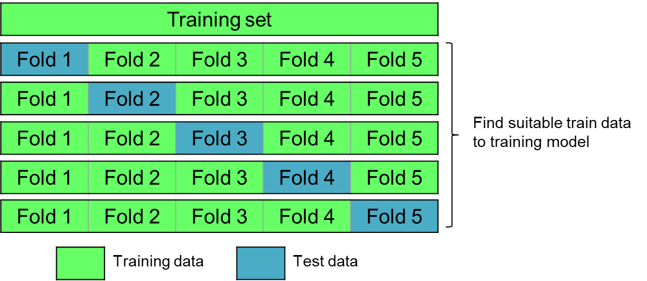
Methodology
Machine Learning Flow
Data
Cross Validation: K-Fold
Data
Preparation
Training Set
Test set
Model
Training
Evaluation
Prediction Model
Figure 13. Example of K-Fold

Slide 7
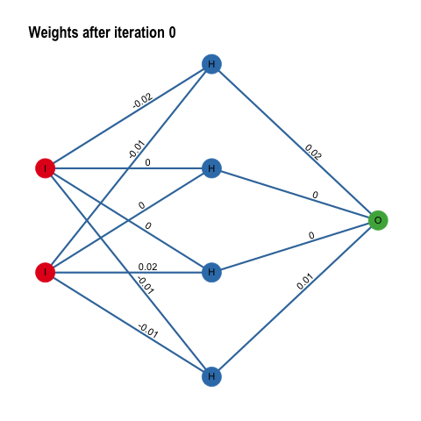
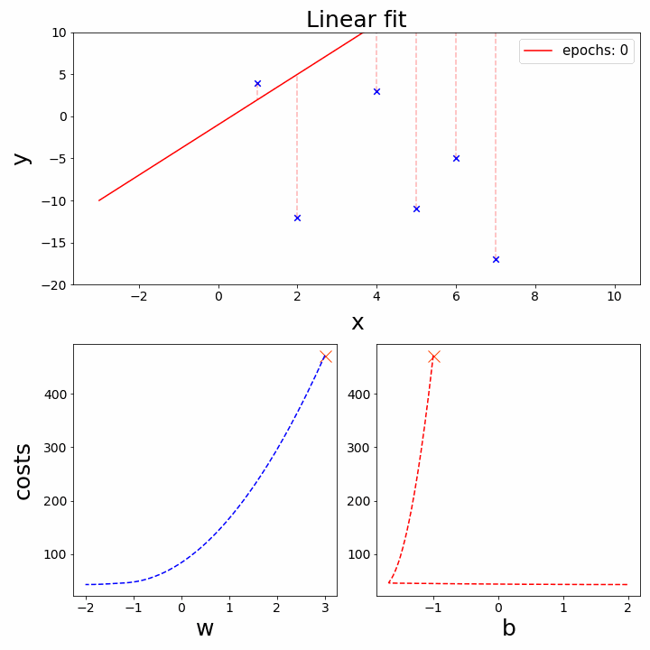
Review Paper
Learning Evaluation
Total Loss = w1*Data Loss + w2*Physics Loss
To get less error, needed to adjust parameter
*w1,w2 = Weight of each loss. Needed to adjust for better learning
Ref [1] : PUFFIN: A path-unifying feed-forward interfaced network for vapor pressure prediction, https://doi.org/10.1016/j.ces.2023.119623
Ref [2] : Gradient Descent animation, https://towardsdatascience.com/gradient-descent-animation-1-simple-linear-regression-e49315b24672
Notes:
เริ่มต้นเราแปลงสูตร SMILES ของสารไปเป็น Fingerprint ที่มี Feature ที่อธิบายโครงสร้างต่างๆภายในโมเลกุล ซึ่งเราจะนำ Fingerprint นี้ไปใช้ในการหา Antione Coefficient ด้วย Deep Learning
โดยการที่ DL จะสามารถทำนายค่า ABC ที่ถูกต้องได้ เราจำเป็นต้องป้อนความสัมพันธ์ Antione Equation และ อุณหภูมิเข้าไป เพื่อให้ปรับค่า ABC ที่ได้ออกมา
หลังจากที่ได้ ABC ของแต่ละสารมาแล้ว ก็จะนำไปคำนวณกับอุณหภูมิของสารดังกล่าว ทำให้ได้ Vapor Pressure ออกมาของสารหนึ่งที่อุณหภูมิหนึ่งออกมา

Slide 8
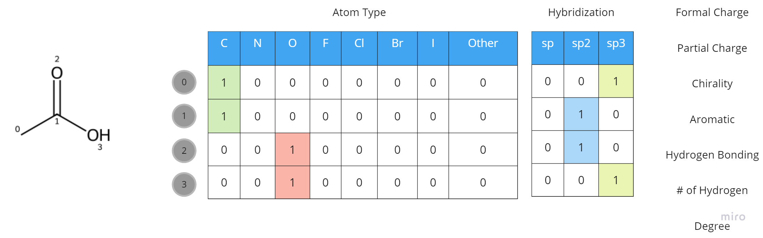
Theory
Molecule to Graph Data
Node Feature
Ref [1] : Featurizers — deepchem 2.7.2.dev documentation, https://deepchem.readthedocs.io/en/latest/api_reference/featurizers.html

Slide 9
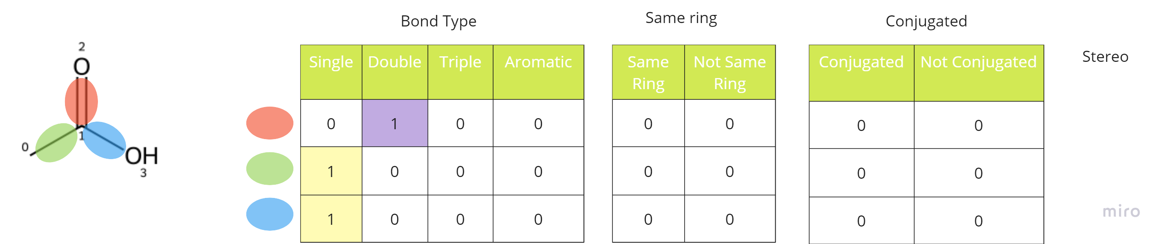
Theory
Molecule to Graph Data
Edge Feature
Ref [1] : Featurizers — deepchem 2.7.2.dev documentation, https://deepchem.readthedocs.io/en/latest/api_reference/featurizers.html

Slide 10
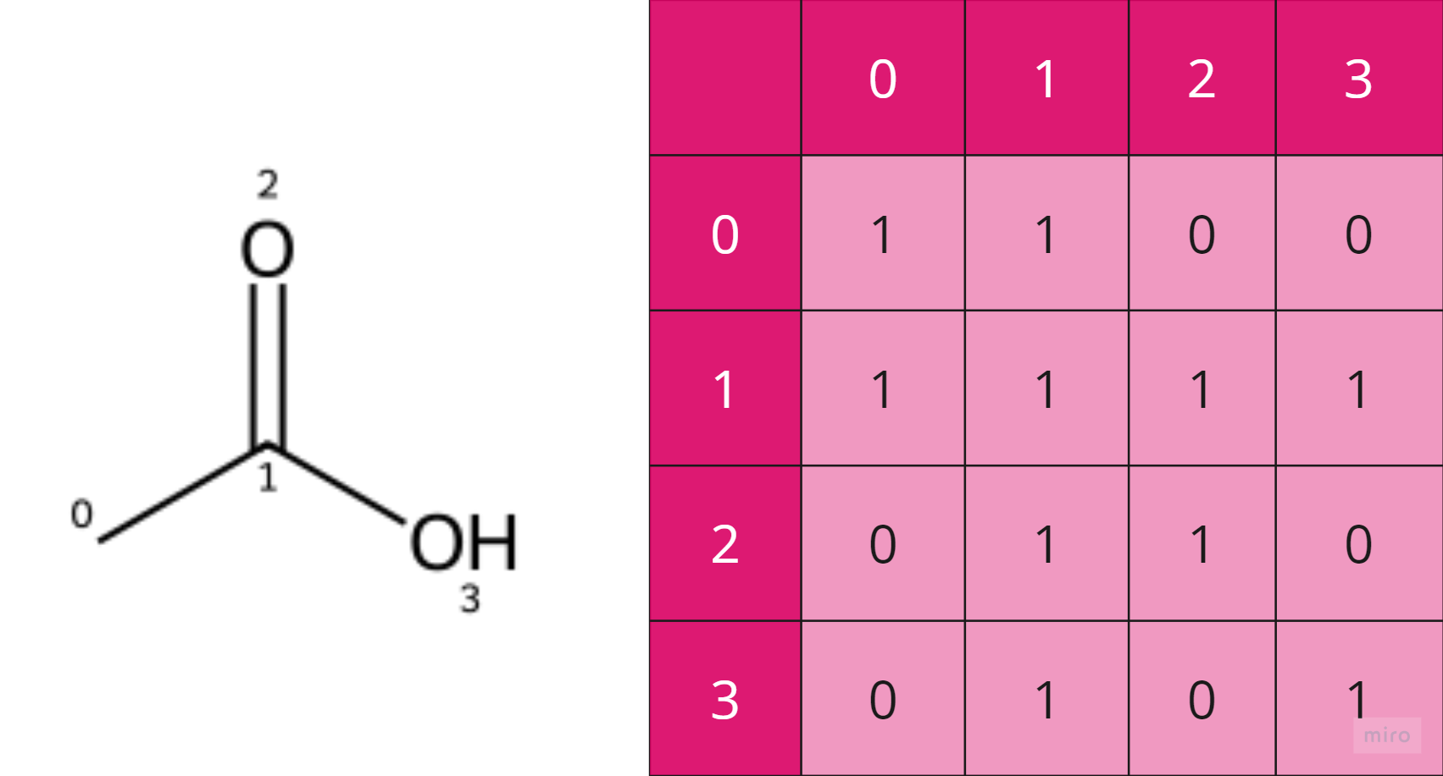
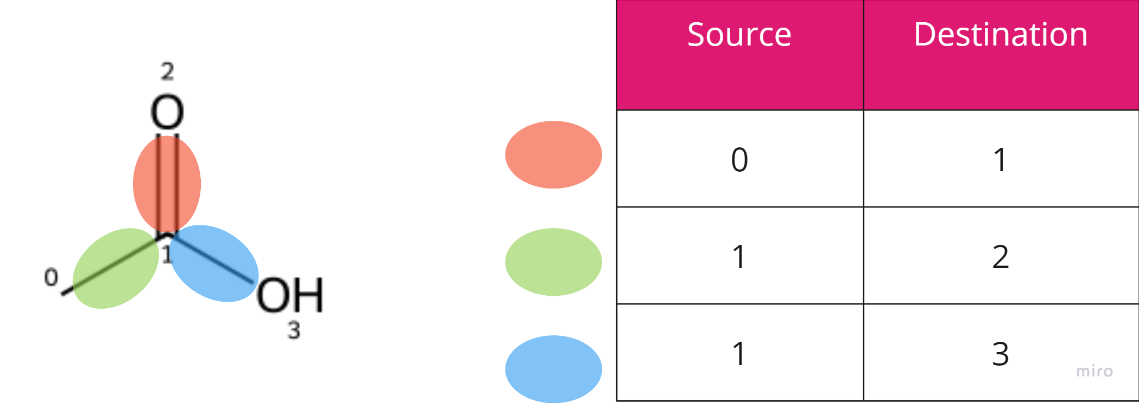
Theory
Molecule to Graph Data
Edge Connection
Ref [1] : Featurizers — deepchem 2.7.2.dev documentation, https://deepchem.readthedocs.io/en/latest/api_reference/featurizers.html

Slide 11
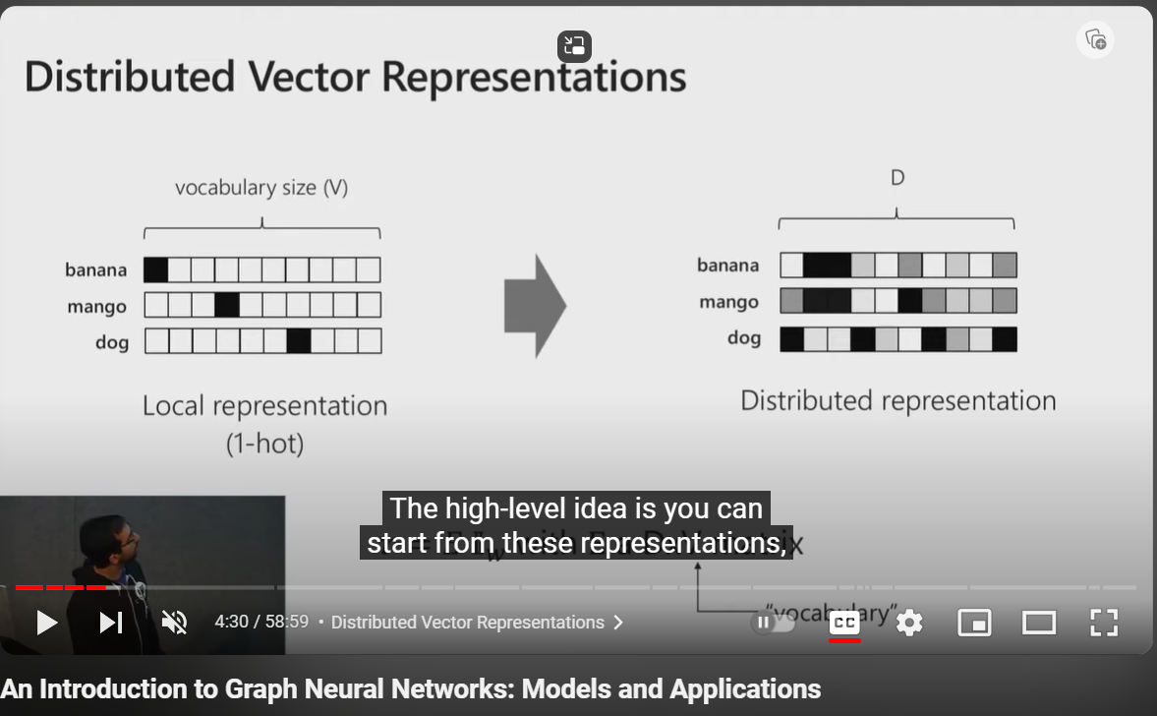

Slide 12
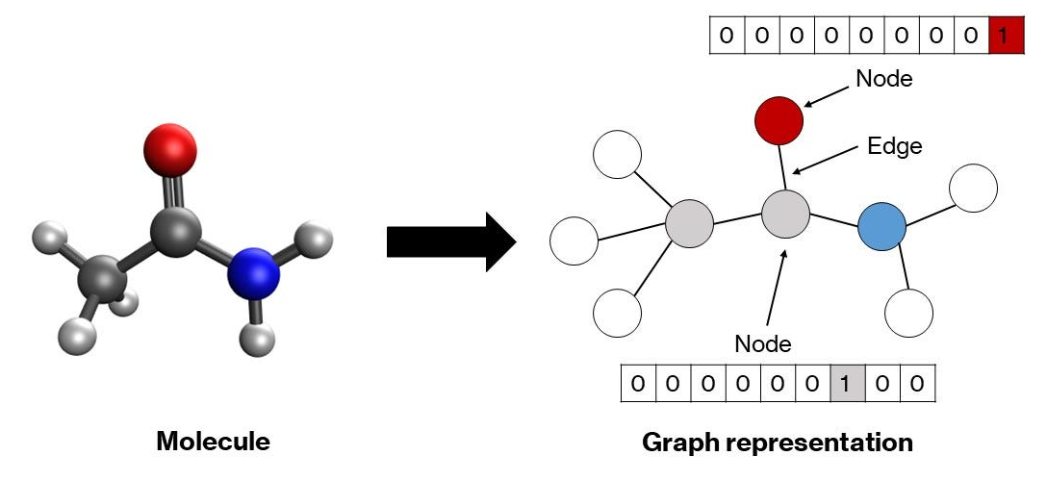
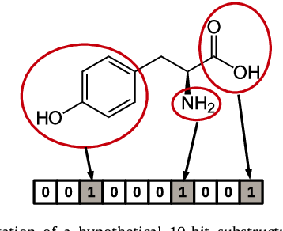
Review Paper
Molecular Descriptor
This Process is to transform SMILES to Numeric Data for representing Molecule that machine can learn.
Feature | Molecular Fingerprint | Molecular Graph
Representation | Compressed bit vector Of Substructures | Explicit atoms, bonds, and Connectivity
Information | Limited structural detail | Full structural information
Notes:
https://www.google.com/url?sa=i&url=https%3A%2F%2Ftowardsdatascience.com%2Fbuilding-a-graph-convolutional-network-for-molecular-property-prediction-978b0ae10ec4&psig=AOvVaw0vMF1l2EG4y9gVGzsLBhK8&ust=1705224988869000&source=images&cd=vfe&opi=89978449&ved=0CBMQjRxqFwoTCLCw9aCI2oMDFQAAAAAdAAAAABAD
https://www.google.com/url?sa=i&url=https%3A%2F%2Fwww.semanticscholar.org%2Fpaper%2FMolecular-fingerprint-similarity-search-in-virtual-Cereto-Massagu%25C3%25A9-Ojeda%2Fe54398c62c5b3d3b587818a98828bc78d29c57be&psig=AOvVaw3ZK9pTr4YxWAwlWrBlbX6h&ust=1705225031820000&source=images&cd=vfe&opi=89978449&ved=0CBMQjRxqFwoTCKDQuLaI2oMDFQAAAAAdAAAAABAY

Slide 13
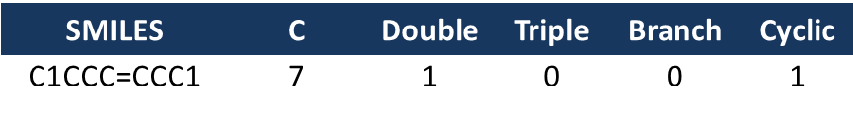
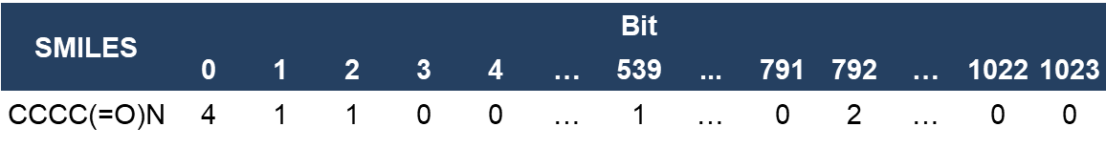
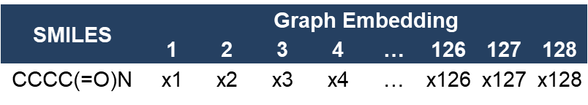
Review Paper
PUFFIN – Molecular Descriptor
5+ Feature | “Diligence”
1024, 4096 Feature | “Amount of Morgan Fingerprint bit is used for storing”
128 Feature | “Initial Feature” and “Embedding size”
1. Molecular Feature
2. Molecular Fingerprint
3. Molecular Graph – (Node, Edge, Adjacent)
Ref [1] : PUFFIN: A path-unifying feed-forward interfaced network for vapor pressure prediction, https://doi.org/10.1016/j.ces.2023.119623
Ref [2] : Featurizers — deepchem 2.7.2.dev documentation, https://deepchem.readthedocs.io/en/latest/api_reference/featurizers.html
Notes:
https://doi.org/10.1016/j.ces.2023.119623
https://deepchem.readthedocs.io/en/latest/api_reference/featurizers.html#convmolfeaturizer

Slide 14
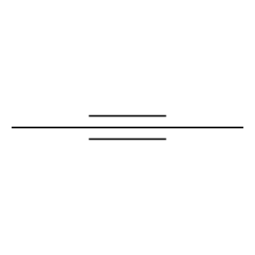
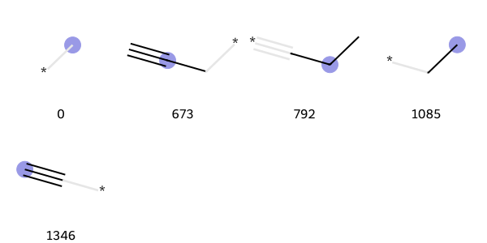
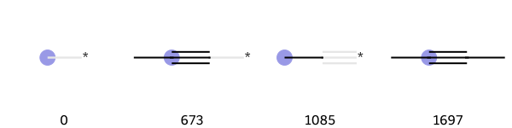
Generate Substructural query
Morgan Fingerprint
Ref. [1] : Getting Started with the RDKit in Python/Generating images of fingerprint bits https://www.rdkit.org/docs/GettingStartedInPython.html
Ref. [2] : Generating Molecular Fingerprints using RDKit https://www.youtube.com/watch?v=-oHqQBUyrQ0

Slide 15
Result
Senior Project, Data 560 point
ML | MAE | MAPE(%) | RMSE | R2
DT | Train = 3.610 Test = 6.238 Total = 4.396 | Train = 0.931 Test = 1.605 Total = 1.133 | Train = 5.503 Test = 9.019 Total = 6.753 | Train = 0.991 Test = 0.979 Total = 0.987
Morgan fingerprint , Data 560 point, 1024 Bit
ML | MAE | MAPE(%) | RMSE | R2
C-MF XGBoost (r=3) | Train = 0.909 Test = 3.512 Total = 1.430 | Train = 0.246 Test = 0.948 Total = 0.387 | Train = 1.768 Test = 5.066 Total = 2.763 | Train = 0.999 Test = 0.992 Total = 0.998
B-MF XGBoost (r=6) | Train = 6.846 Test = 21.24 Total = 9.726 | Train = 2.107 Test = 5.701 Total = 2.826 | Train = 11.71 Test = 28.65 Total = 16.55 | Train = 0.961 Test = 0.750 Total = 0.921

Slide 16
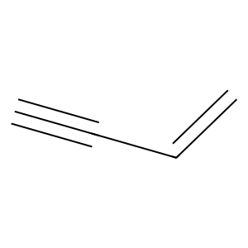
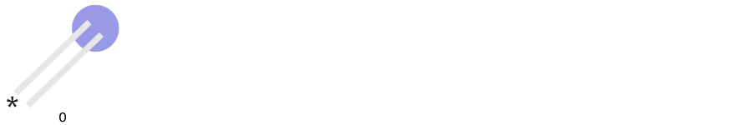
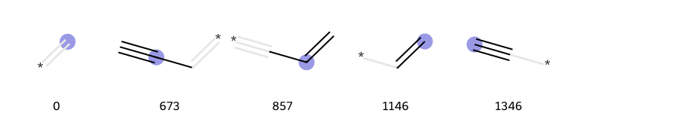
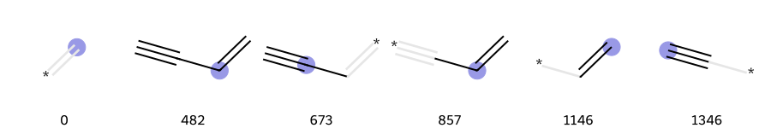
SMILES | C=CC#C
bit=2048
r=0
r=1
r=2

Slide 17
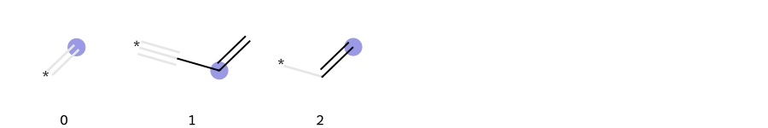
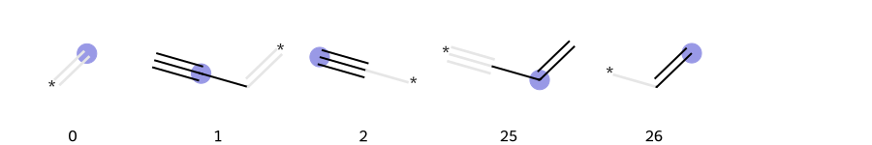
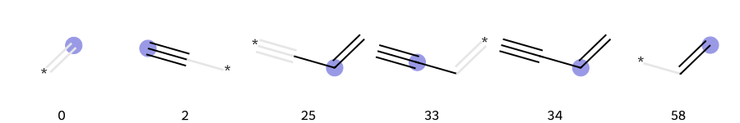
SMILES | C=CC#C
r=3
nBits = 8
nBits = 32
nBits = 64

Slide 18
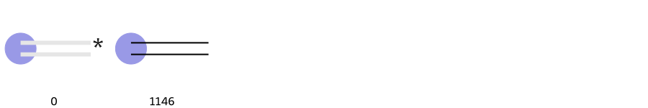
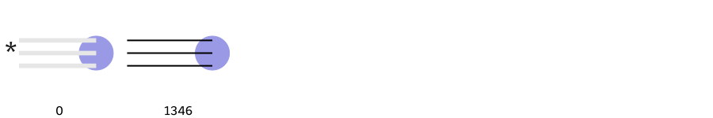
r=3, bit=2048
C=C
C#C
C=CC#C
Notes:
File : Problem 1_10_2023

Slide 19
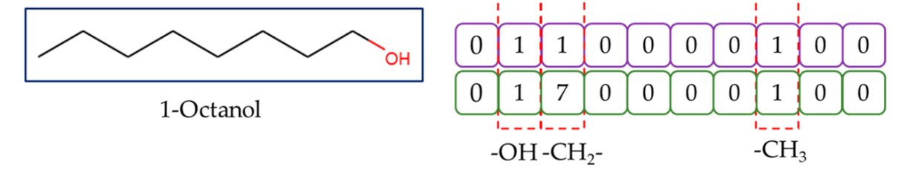
Count-based Morgan Fingerprint
Ref. [3] : Count-Based Morgan Fingerprint https://doi.org/10.1021/acs.est.3c02198

